Slide 1
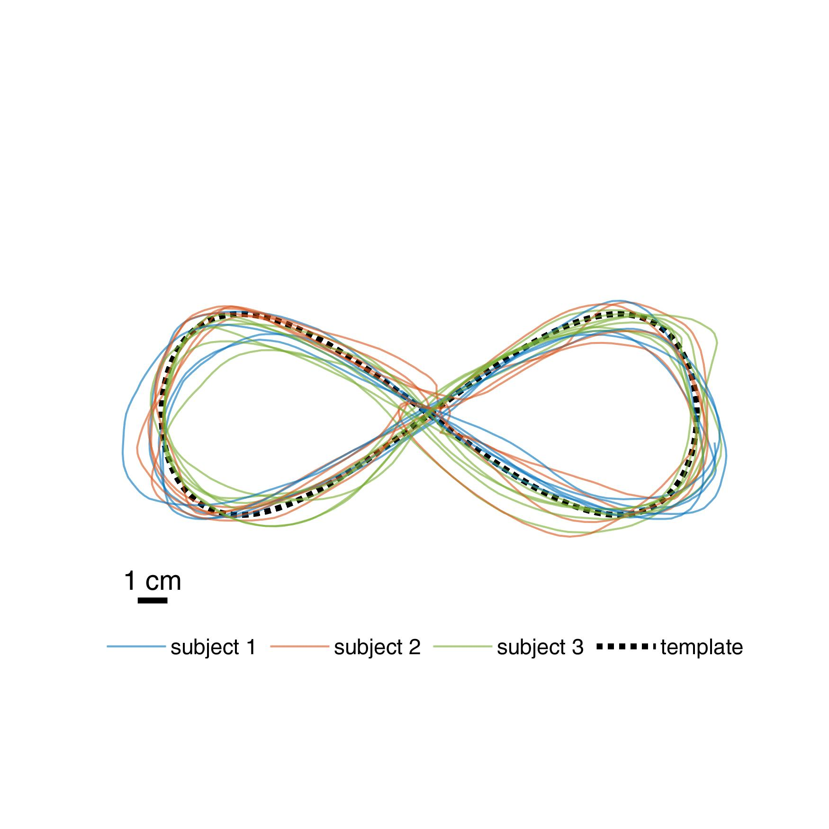
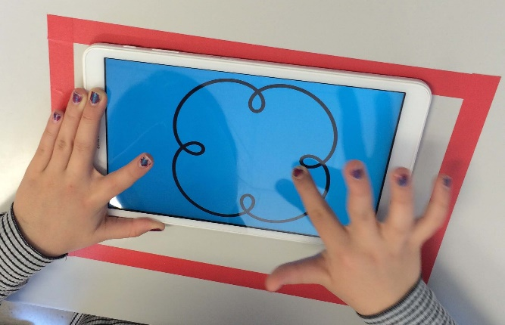
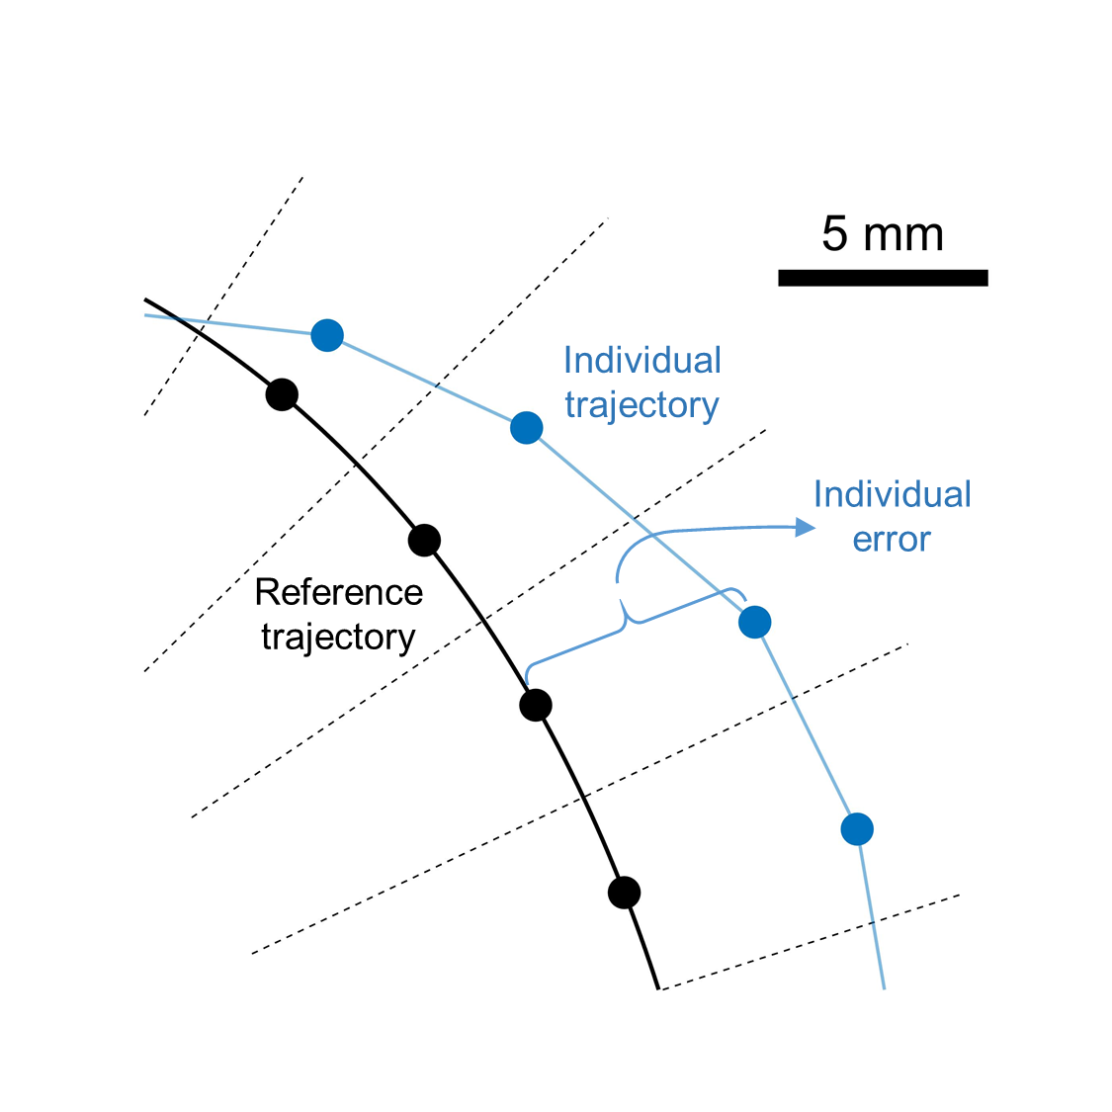
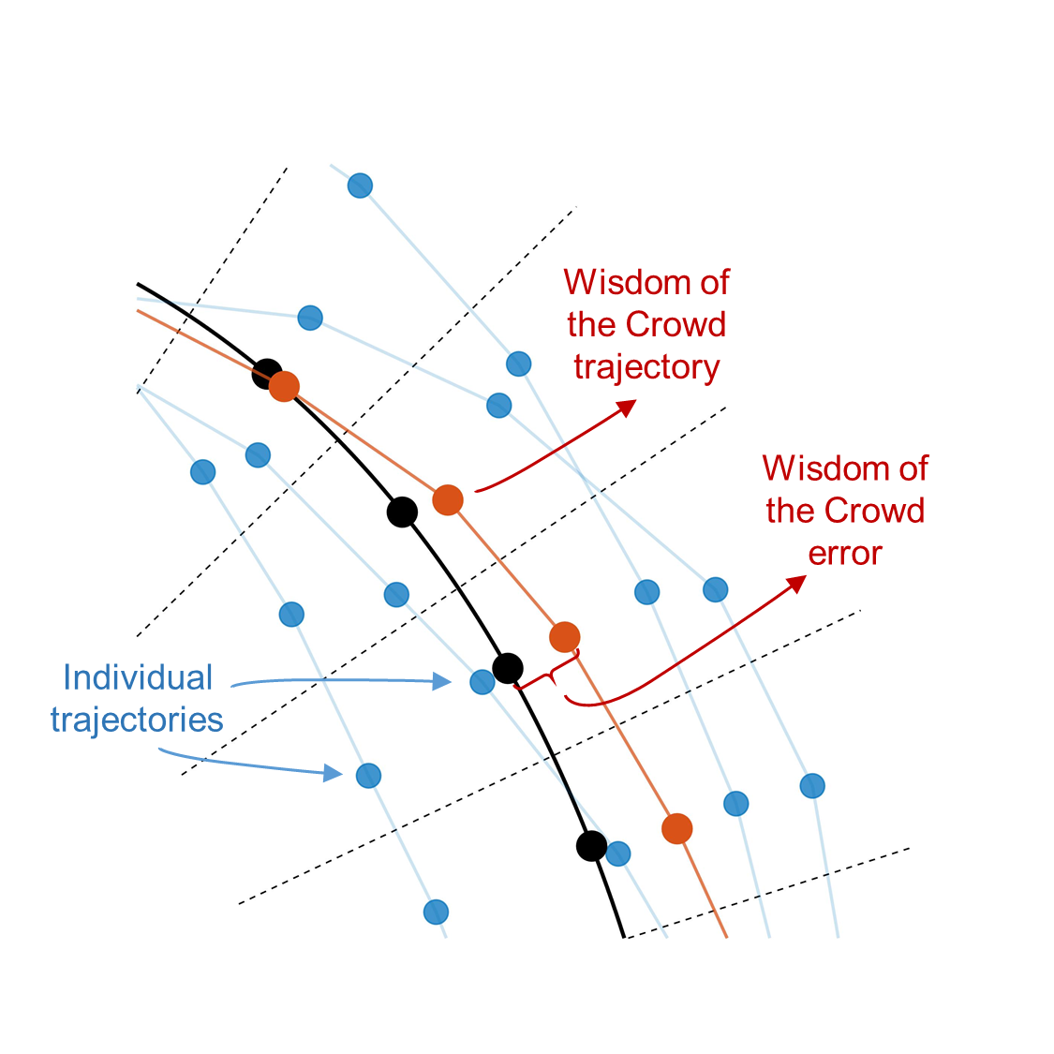
(a)
(b)
NOT YET CROPPED!
(c)
Computation of aggregate trajectory (Wisdom of the Crowd) and its errors
Computation of individual errors

Slide 2
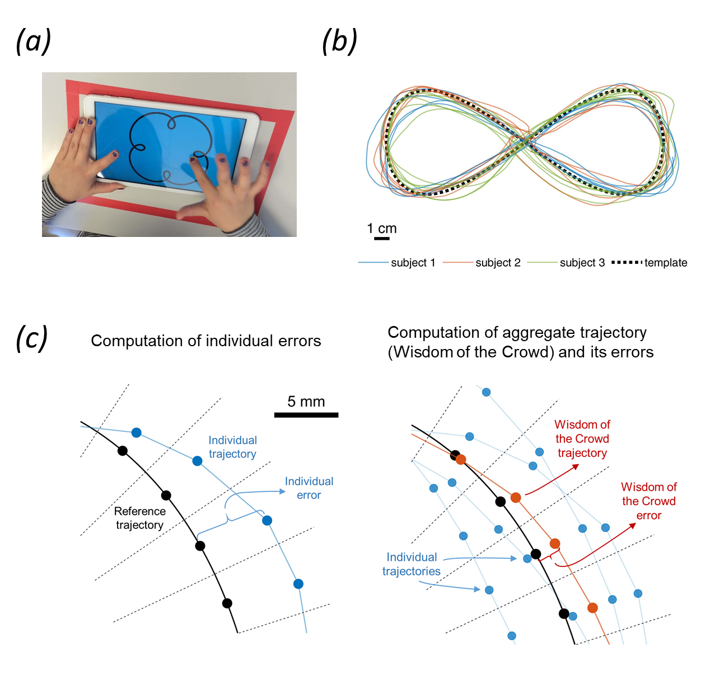
CROPPED!

Slide 3
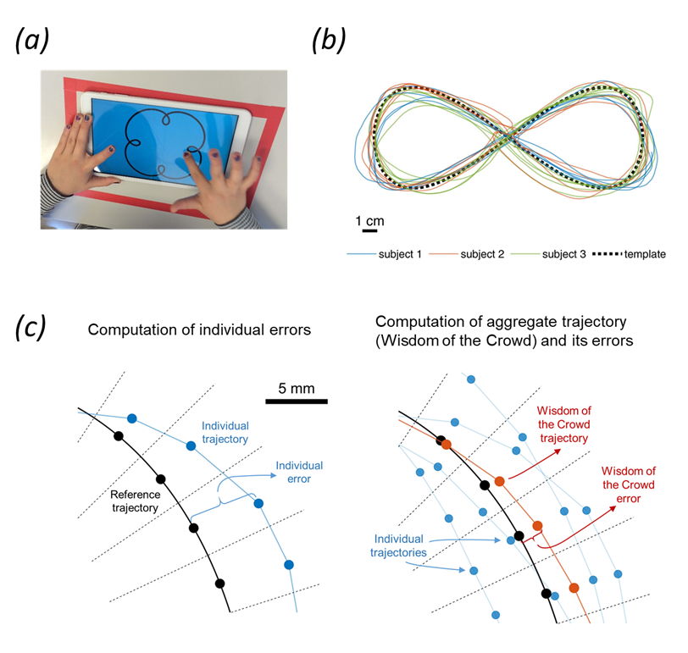
CROPPED
AND SAVED AS FIGURE

